Slide 1
Informal working group on ADR and Waste
19 November 2020 9.00 am – 1.00 pm

Slide 2
Technical practicalities
For an efficient and clear meeting

Slide 3





House rules
Technical practicalities
Keep your microphone muted; activate it only if you want to talk;
Camera is optional; if connection is bad, it is advisable to switch it off;
If you want to talk, raise your hand (TEAMS icon);
Subtitles will be activated (English only).
Organizational practicalities
Keep your intervention structured and clear (target max 90 sec.);
Use the chat function for short communications;
Ask the moderator if you want to share documents/screen.

Slide 4
Tour de table
Who is participating

Slide 5
Proposed agenda

Slide 6
Agenda proposal
Ref. based on (1) minutes Utrecht meeting and (2) working documents Joint Meeting Geneva
9h00-10h00: discussions on pending Issues from last informal WG (07 October)
Working Document 57 on “transport of asbestos in bulk”
Working Document 02 on “bulk carriage of waste batteries”
Working Document 61, weight estimation: review adjusted proposal
Issue 1.1 on “exemption of pharmaceutical products (medicines) ready for use”
10h10-13h00: discussions on selected issues
(New) Issue 2.2: Transport of packaged waste: inner packaging's packed together
(New) Issue 2.5: Chemical compatibility
Issue 4.2: Additional information responsible person for class 6.2
Proposal for multilateral agreement on Document 62
Working Document 54 on “removable dumpster placarding”.

Slide 7
History of the informal WG
See previous reports

Slide 8
History of the informal working group
After several punctual proposals of updating the ADR, FEAD proposes to initiate an informal working group on ADR and waste
The Autumn session 2018 of the Joint meeting asks FEAD to lead the Informal WG
April 2019: first Informal WG Brussels: selection of issues for further consideration
Joint meeting autumn 2019: confirmation of the selection + 1 issue
March 2020: second informal WG Utrecht: 10 issues selected, 5 working documents to be finalized
September 2020: Joint meeting approves 2 working documents
07 October 2020: Third informal working group held online (9 MS present)

Slide 9
Decisions taken by the 2020 Autumn session’s Joint meeting
14.09 – 18.09 2020

Slide 10
2020 Autumn session of the Joint Meeting
WD 51 on polymerizing waste (D) → supported with fine-tuning
WD 57 on asbestos in bulk (F) → supported with fine-tuning
WD 60 on scope UN 3509 (FEAD) → approved
WD 61 on quantity information (FEAD) → supported with fine-tuning
WD 62 on sheeted containers for UN 3509 → approved
WD 02 on carriage in bulk of batteries (Fi) → sent to the informal WG.

Slide 11
Summary previous informal WG dd. 7.10.2020
See meeting Report

Slide 12
Third Informal working group meeting (7 October)
The following elements have been agreed upon:
Need for further analysis: issue 4.2 on “additional information”, document 57 on “transport of asbestos in bulk”, document 0.2 on “carriage of waste batteries in bulk”.
Need for finalization: issue 1.1 on “exemption of pharmaceutical products (medicines) ready for use” (by FEAD), working document 61 on “weight estimation” (all), document 51 on “polymerizing substances” (by Germany).
Need for further information from MS: issue 1.1, document 0.2, proposal for multilateral agreement for document 62 (Belgium, Finland), issue 3.3 on “ transport of aerosols in bulk” (Austria).
Introduction of point 2.2 on “transport of packaged waste” and point 2.5 on “chemical compatibility” postponed to November.

Slide 13
Working document 57: transport of asbestos in bulk (France)

Slide 14
WD 57: Carriage in bulk of waste containing asbestos
Context
RID/ADR prohibits the carriage of asbestos in bulk (UN Nos. 2212 and 2590). The informal working group on the transport of hazardous waste, which met in Utrecht, the Netherlands, from 3 to 4 March 2020, discussed this item and found it necessary in certain cases to allow for the carriage of asbestos in bulk under certain conditions.
After previous informal WG extra input from France was asked.
Input from member states
France and FEAD (FNADE), feedback of meeting 5/11/2020
Belgium, input provided by OVAM (Flemish Environmental Administration):
  Benchmark technical data Liner bags producers Asgrobenne (F) and Vercom International (Nl)
Discussion on special provision 168: need for interpretation, definition and clarification of scope.

Slide 15
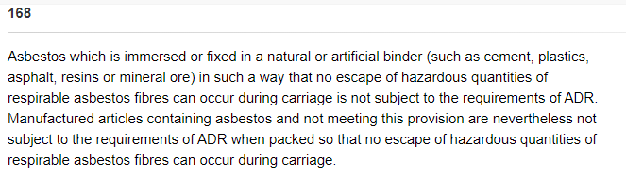
Special provision 168

Slide 16
Working document 02: Waste
Batteries / used storage batteries, carriage in bulk (Finland)

Slide 17
WD 02: waste batteries / used storage batteries, carriage in bulk
Context
Clarify the meaning of AP8 and its requirement to take account of any residual
currents. Discuss input provided by reports of different member states.
Incident reports
Netherlands, bulk transport without protective plastic liner on the inside. Incident due to contact container and unprotected battery. (Report LINK)
France, incident occurred with new non-insulated batteries. (Report LINK)
Finland, spare power batteries present = Li-batteries? (Report LINK)
Actions
Need to consider a modification of AP 08 and introduce the requirement for plastic liners.

Slide 18

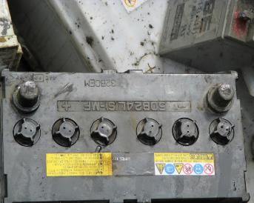
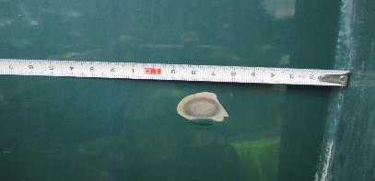
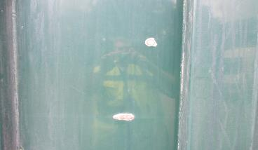
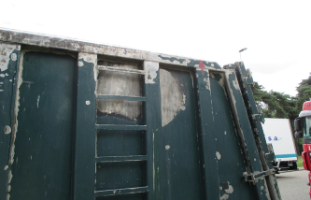
Pictures

Slide 19
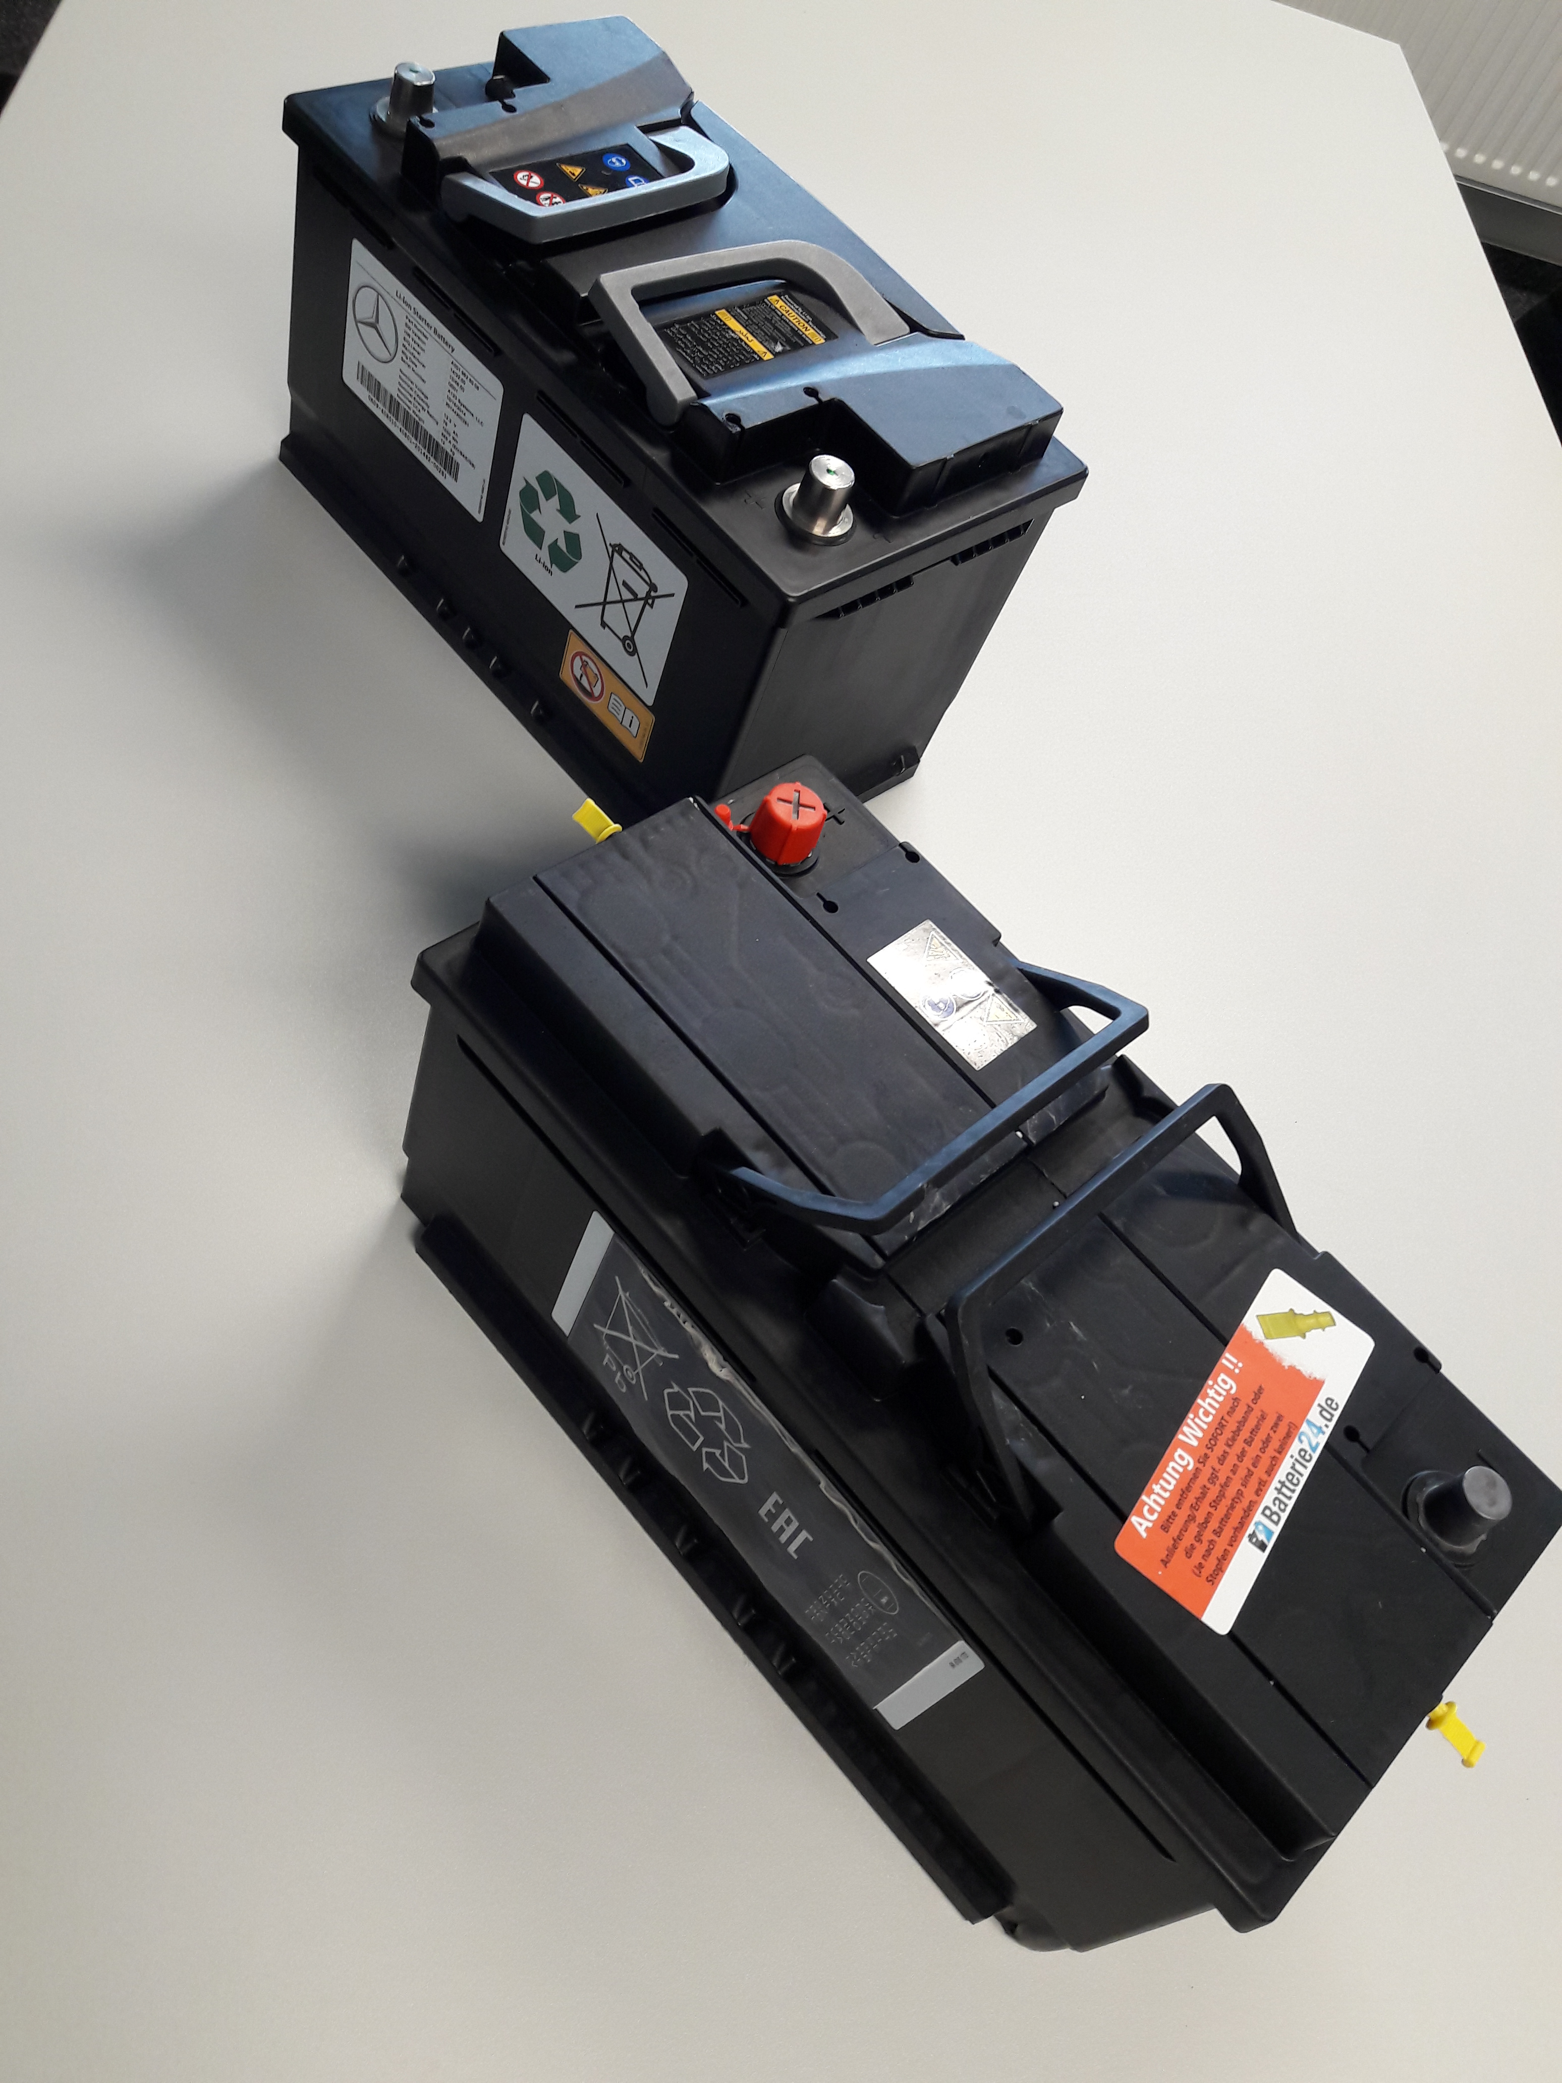
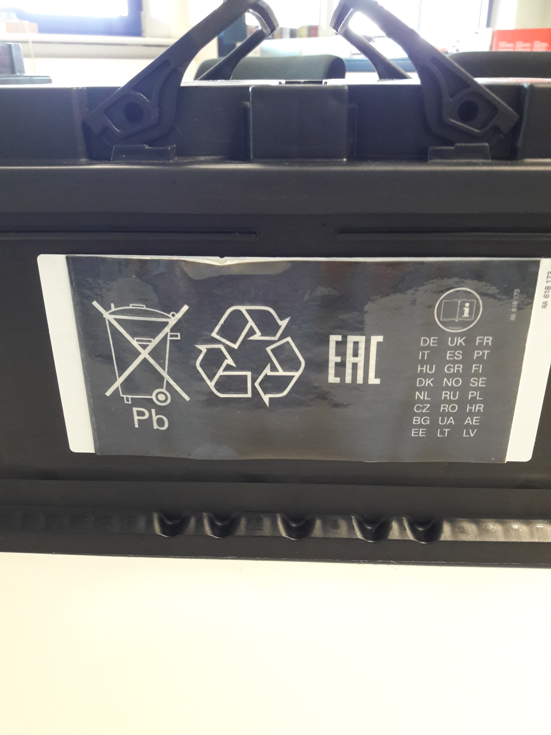
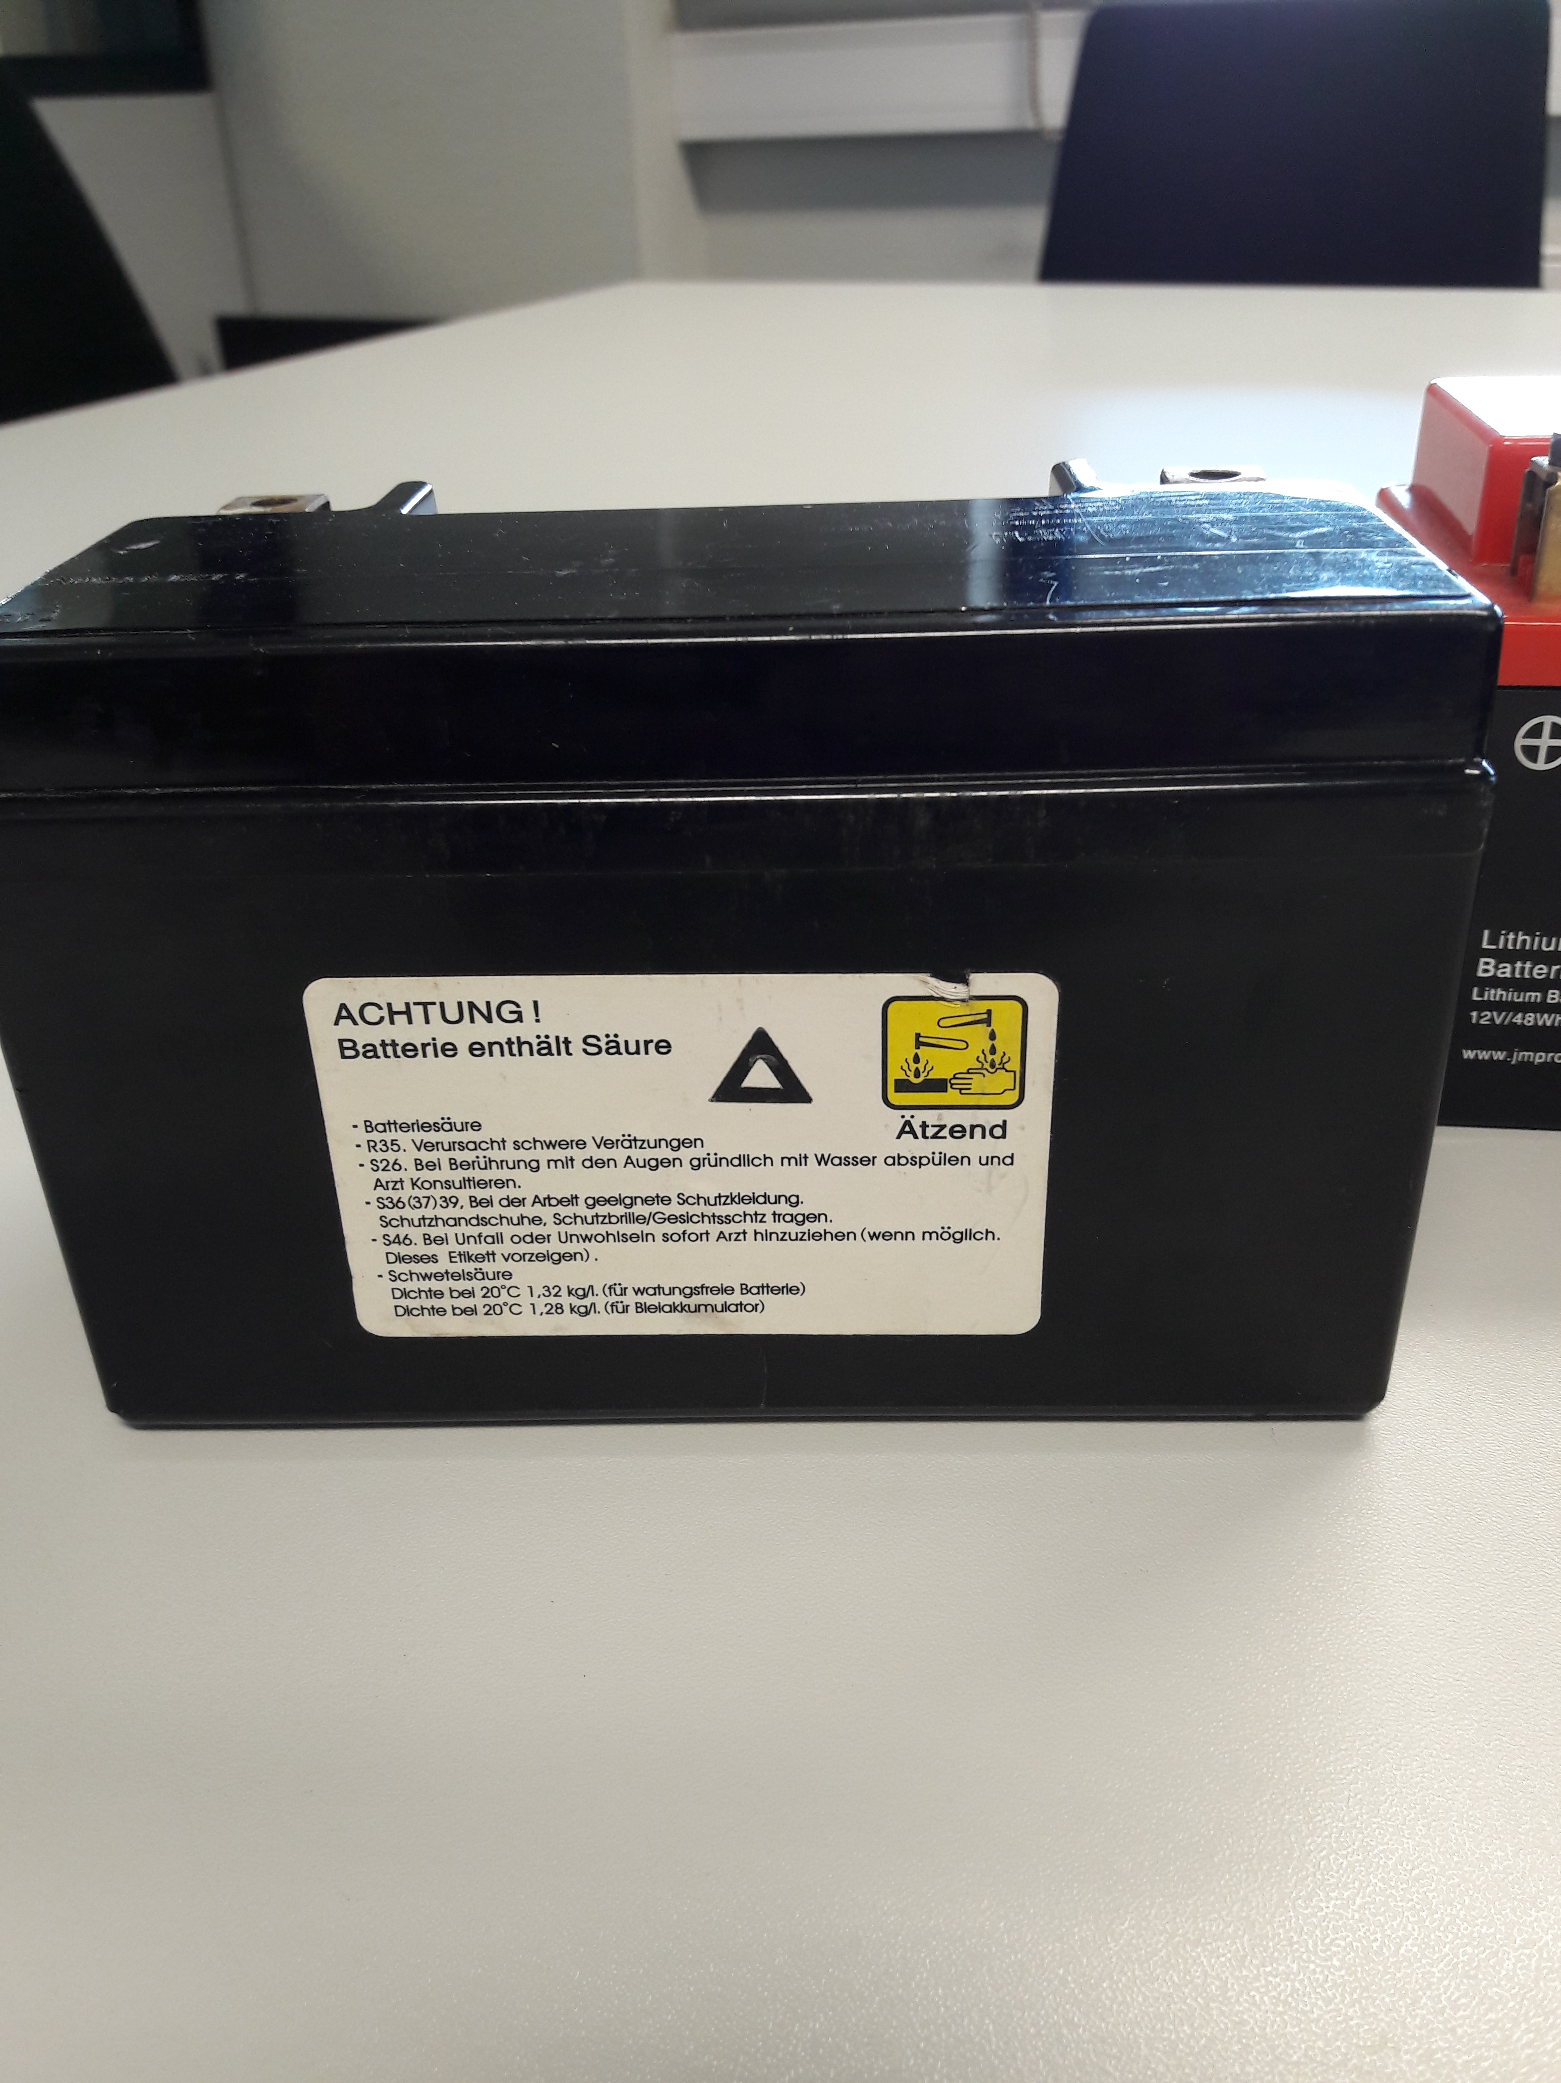
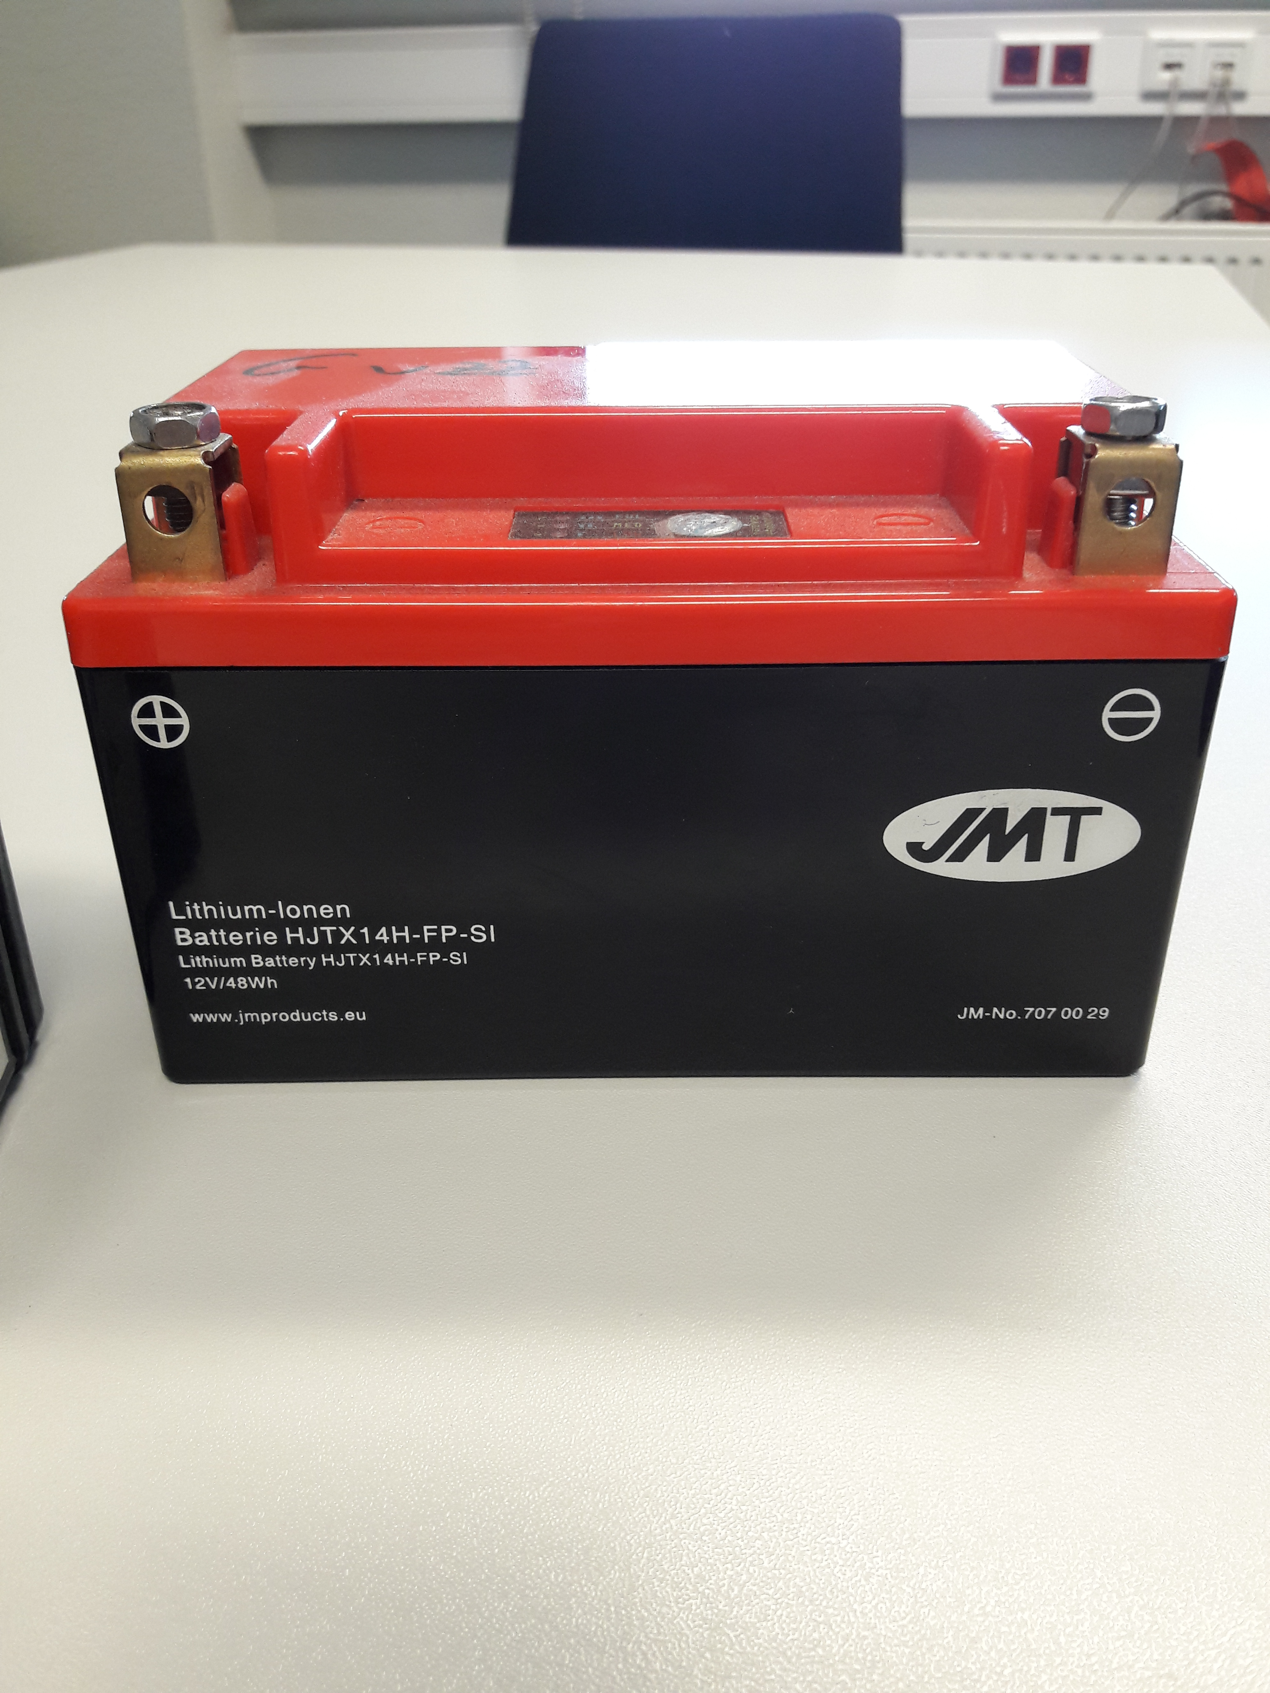
Pictures of Li-batteries

Slide 20
Additional provision AP 8
The design of the load compartment of vehicles or containers shall take account of any residual currents and impacts from the batteries.
The load compartments of vehicles or containers shall be of steel resistant to the corrosive substances contained in the batteries. Less resistant steels may be used when there is a sufficiently great wall thickness or a plastics lining/layer resistant to the corrosive substances.
NOTE: Steel exhibiting a maximum rate of progressive reduction of 0.1 mm per year under the effects of the corrosive substances may be considered as resistant.
The load compartments of vehicles or containers shall not be loaded above the top of their walls.
Carriage is also permitted in small plastics containers which shall be capable of withstanding, when fully loaded, a drop from a height of 0.8 m onto a hard surface at
-18 °C, without breakage.

Slide 21
Working document 61: weight estimation (review adjusted proposal)

Slide 22
WD 61: weight estimation (review of adjusted proposal)
Context
FEAD has been asked to make some modifications on the based of comments received during the third informal working group meeting (7 October).
Incident reports
Working document 61 has been updated (see here) as of the corrections approved on 7 October.
Actions
Additional discussions are needed on the optimal placement of these provisions – either under 5.4.1.1. or under 5.4.1.1.3.

Slide 23
Issue 1.1: exemption of pharmaceutical products (medicines) ready for use

Slide 24
Issue 1.1: exemption of pharmaceutical products (medicines), ready for use
Context
“Currently special provision 601 refers to the origin of the material, not on the content. That means that it is no more applicable ones the product becomes a waste. In other words, once pharmaceuticals become a waste, they are no longer exempted from the ADR”
Proposal
New proposal was drafted and modified according to the last informal WG’s suggestions (LINK to document).
Actions
Inputs of national requirements from member states are needed (in particular for Sweden, the UK and Finland.

Slide 25
Comfort Break ~ 10 minutes

Slide 26
Issues 2.2: transport of
packaged waste, inner packagings packed together
and Issue 2.5: chemical compatibility

Slide 27
Issue 2.2 & 2.5: packaged waste & chemical compatibility
Context
Original products are packed in a combined packaging, specifically tested for that purpose (see ADR 6.1.5). For waste collection, only the inner packaging remains available. This waste must be sorted, according to its hazardous properties, and be repacked fulfilling all the requirements of the ADR, which is not possible. There is a lack of a simple legal solution available to replace the missing outer packaging
During reconditioning, waste is taken out of its original single packaging and brought together with other compatible waste in a ‘new’ waste packaging, UN-tested. As the composition of the mixture is not stable and changes for each used packaging, a solution has to be developed regarding the chemical compatibility
Proposal and actions
Several national derogations exist (see next slides)
Discussion during the meeting on harmonization at ADR level.

Slide 28
Chemical compatibility: goods vs waste status (REACH)
R
E
ACH
REGISTRATION
EVALUATION
AUTHORISATION
PRODUCTION OF DANGEROUS GOODS
USE
AND PROCESSING
HANDLE
END OF WASTE STATUS = GOODS
-------------------------------------------------------------------------------------------------------------------------------------------
RECYCLING
ENVI/OSHA
WASTE
WASTE STATUS
DISPOSAL

Slide 29
Chemical compatibility: goods vs waste status (ADR)
A
D
R
SDS
UN - TEST
HANDLE
DGSA
PRODUCTION OF DANGEROUS GOODS
USE
AND PROCESSING
END OF WASTE STATUS = GOODS
COLLECTION
PROCESSING
-------------------------------------------------------------------------------------------------------------------------------------------
ENVI/OSHA
WASTE
DISPOSAL

Slide 30
Dangerous goods with a Commercial Status Dangerous goods with a Waste status
High level ADR-Involvement
Poor level / No ADR - Involvement
ENVI & OSHA
High level ADR-Involvement
Niew transport chain
Producer
Sender
Conditioner
Transport chain ADR-classification used (from SDS)
End user
Transport
Disposer
Objective: new product
Waste Collector
Industrial use (new production
Research on legal conformity
Transporter
Intermediate storage
Commercial (professional use)
Exemption 1.1.3.1.c) Yards
Testing or calculation of hazard
Discharger
Private use
Exemption 1.1.3.1.a)
Development of SDS including
Heading 14
SDS available : No SDS available No SDS available
Known Classification Classification to be defined
Added value to comply with the rules (time,…) No added value (margin/time)
Specialized staff
Test on chemical compatibility
Packaging conform testing
Standardized packaging No standardization of packaging
Limited production range Wide range of products/waste

Slide 31
COMMERCIAL STATUS
100 % ADR
User STATUS
0 % ADR
WASTE STATUS
X? % ADR
PRODUCER/SHIPPER/PACKER
INDUSTRIAL USER
PRODUCER(generator)/SHIPPER/PACKER
SDS is generally missing for waste and always for mixtures
SDS available but NO info on Waste
SDS provided but NO info on Waste
DGSA present and supporting
DGSA ‘supervision’
DGSA present and supporting
Environmental and Safety & Health rules>>> other rules:
cardboard outer package -> recycling
no pouring of content of jerrycans in larger drums (for safety reasons)
Envi & safety&health rules >>> other rules
Long development phase, justifying and including:
UN-testing / classification of dangerous properties
UN-testing of packaging
Testing chemical compatibility with plastic
COMMERCIAL USER WITHOUT (e.g. Labs) OR WITH TRANSPORT (e.g. Yards)
Waste status (value/diversity, variability) does NOT allow:
UN-testing of dangerous properties
UN-testing of packaging
Chemical compatibility test for plastic
SDS provided but NO info on Waste
Exceptional use of mixed packaging
DGSA present and supporting
Staff trained on ADR
Generally a WIDE range of dangerous goods is produced as waste on one site
Optimized use of standard packaging
Environmental &safety&health rules >>> other rules
Test reports of packaging are missing
Generally a limited range of dangerous goods produced
Waste is often mixed, to be classified as n.o.s. (test of chemical compatibility almost impossible (time limit)
PRIVATE USER
TRANSPORT
Only CLP-information is available
Poor knowledge of ADR by staff – support of waste partner (collector) required (contract)
ADR Exemptions 1.1.3.1.a for Citizens and 1.1.3.1.c for Yards
Simple application of numerical list of dangerous goods and general ADR- requirements

Slide 32
National derogations (1)
Austria (multilateral agreement M287)
Use of expired packaging or not UN tested packaging for dangerous wastes of Packing Group III and Group II (corresponding to the wastes defined in Annex of the agreement)
Packagings may have buckels and dents.
Belgium
Allowance of packaging of inner packaging, which contains waste, in outer receptacles
Outer receptacles need to be closed during transport (except during door-to-door collection from municipal sources)
Individual receptables must be used for each class, also goods cannot be packed together if they react dangerously
Outer receptable for packing group 1 waste must comply with requirements for packing group 1 (§4.1.1.3).

Slide 33
National derogations (2)
Denmark
Packing of inner packagings containing waste in outer packagings and or overpacks is allowed under special consignment procedures including special packing and marking restrictions.
Waste must be packed in an outer packaging that is marked with an X or Y
See more details in document – p. 28-32 (LINK).
France
Combination of:
  Original inner packaging (brought by citizens)
  Plastic bag
  UN-tested big bag
  Non-UN tested palletbox
  Only applicable for solid and paint waste.

Slide 34
National derogations (3)
Germany (Ausnahme 20)
Classes 2 to 6.1, 8 & 9, combined packaging and transportation in packs and IBC’s. Waste must be packaged in internal packaging
Categorization in specific waste groups & use of special written instructions
Only outer packaging in types that are UN approved for solids of packing group 1 (X marking).
Sweden
Packing of inner packagings in IBC’s and large packagings
Packagings and IBC’s need not to be tested as prepared for carriage with a representative sample of small inner packages
Outer packagings need to be UN tested for packing group I and II (X and Y) and contain absorbent material.

Slide 35
National derogations (4)
Switzerland
More information on p.45-46 of this FEAD document (see here).
The Netherlands
Packaging in develoment especially designed for waste to be used as external
packaging for different kind of inner packaging
At present: UN-tested open drums.

Slide 36
National derogations (5)
USA
More information on national US derogation on p. 47-49 of this FEAD document (see here).

Slide 37
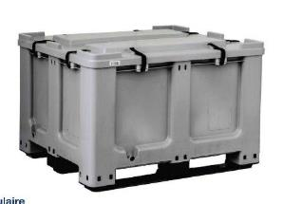
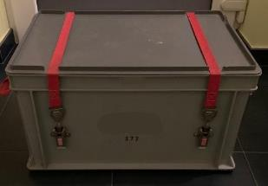
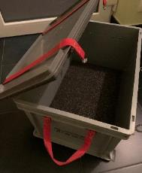
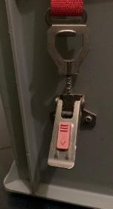
Overview of used outer packagings (1)
IBC 11H2
Small hazardous waste box
(X marking)

Slide 38
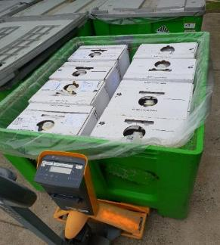
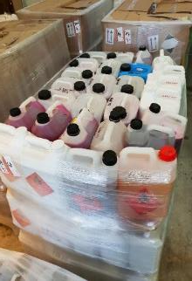
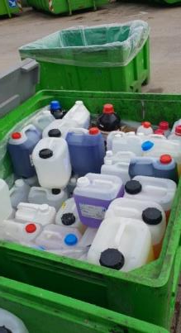
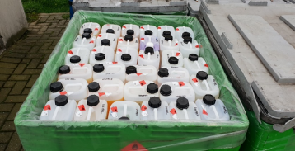
Overview of used outer packagings (2)
Outer receptacles

Slide 39
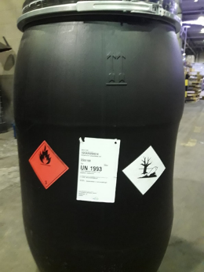
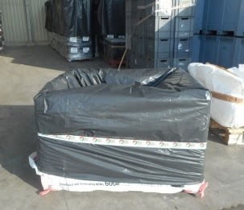
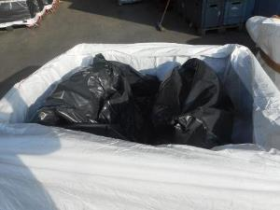
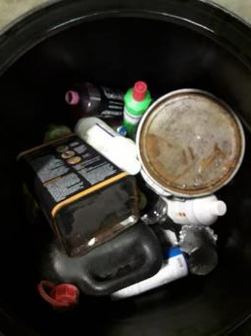
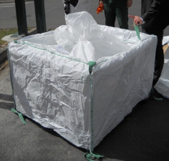
Overview of used outer packagings (3)
UN-tested open drum
UN-tested big bags

Slide 40
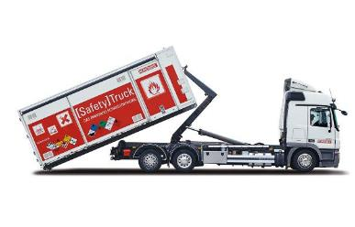
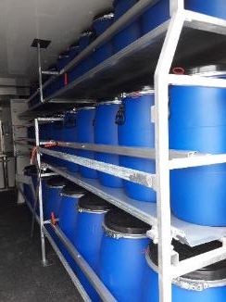
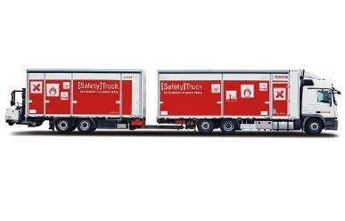
Overview of used outer packagings (4)
Waste drums inside safety truck
Safety truck

Slide 41
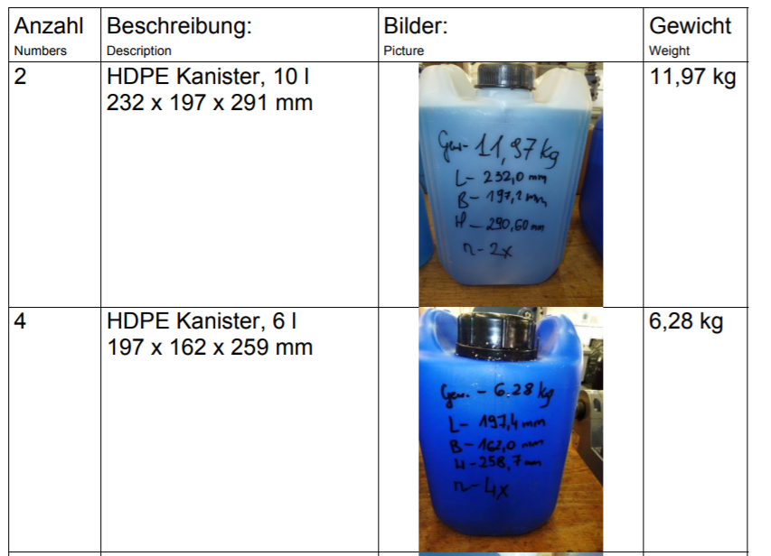
Summary test results from The Netherlands (1)

Slide 42
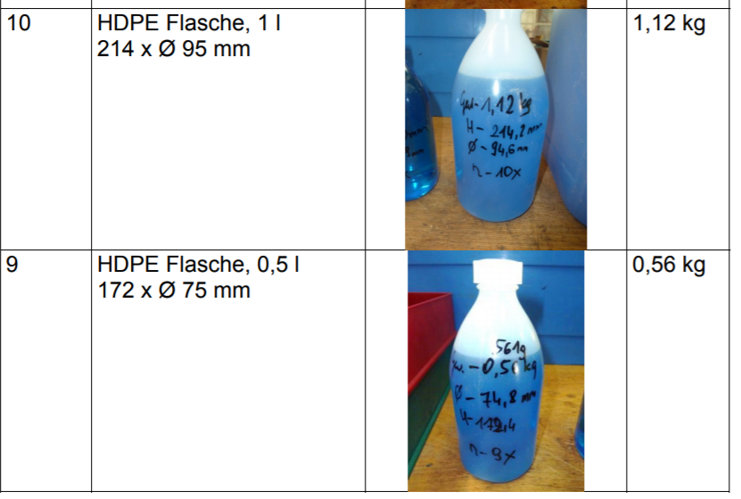
Summary test results from The Netherlands (2)

Slide 43
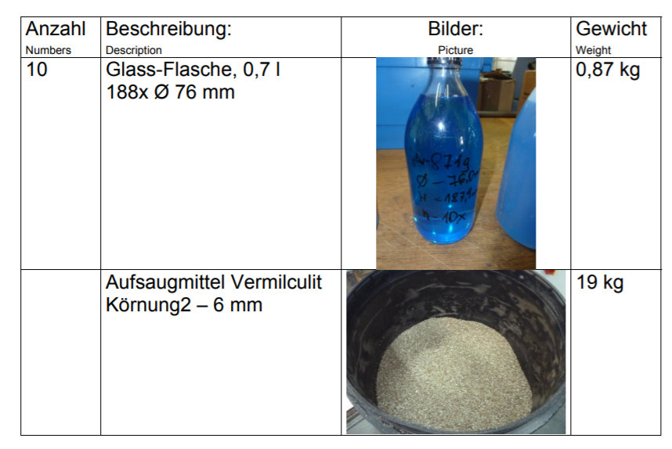
Summary test results from The Netherlands (3)

Slide 44
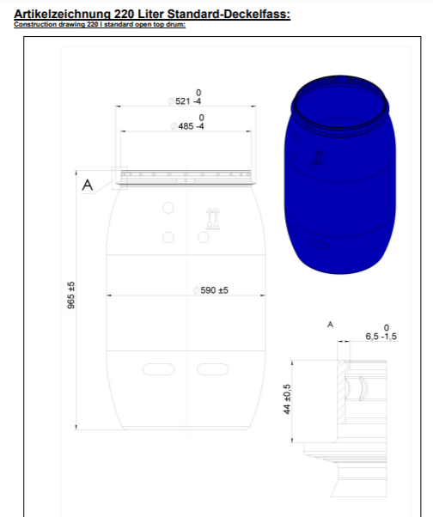

UN-tested waste drum
from The Netherlands

Slide 45
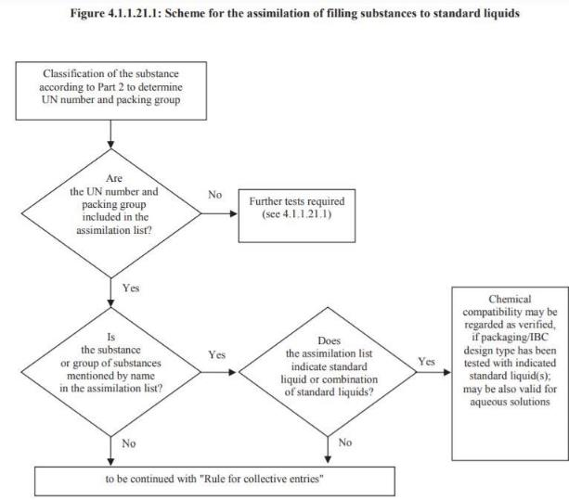
Chemical compatibility (2)

Slide 46
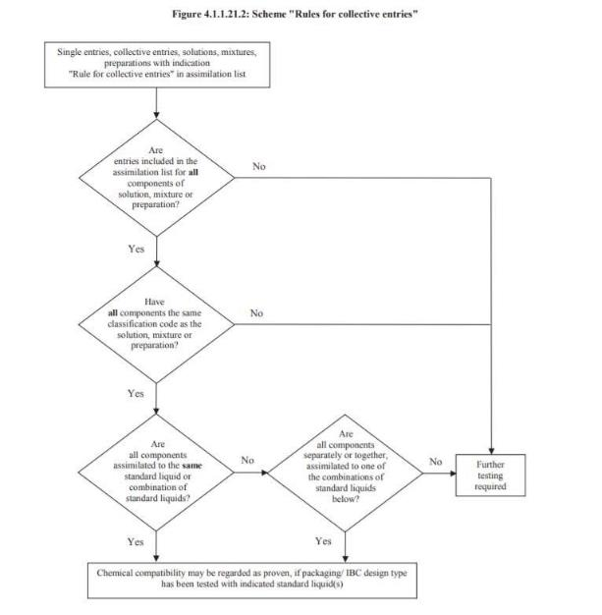
Chemical compatibility (3)

Slide 47
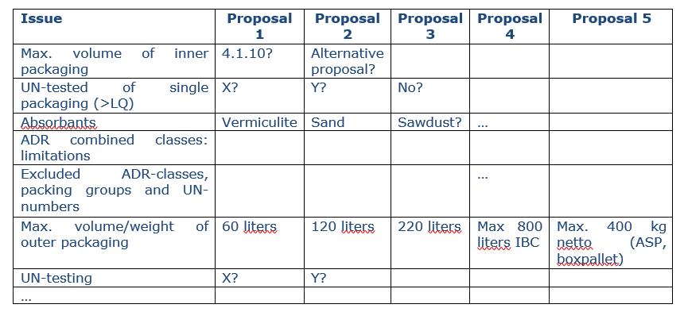
Proposed specifications

Slide 48
Issue 4.2: additional information responsible person for class 6.2

Slide 49


Issue 4.2: additional information responsible person for class 6.2
Context
ADR presently requires in 5.4.1.2.4 as an additional provision for Class 6.2: ‘In addition to the information concerning the consignee (see 5.4.1.1.1 (h)), the name and telephone number of a responsible person shall be indicated.’
Requirements from the “orange book”

Slide 50
On Issue 4.2: analysis of EU Directive 2005/54
EU Directive 2000/54 on the protection of workers from risks related to exposure to biological agents at work
Objective: this Directive lays down minimum requirements for the health and safety of workers exposed to biological agents at work.
Article 6: reduction of risks
“point (h): means for safe collection, storage and disposal of waste by workers including the use of secure and identifiable containers, after suitable treatment where appropriate” => definition not clear.
Article 7: information for the competent authority
Section 1, point (d): “the name and capabilities of the person responsible for safety and health at work”

Slide 51
Issue 4.2: additional information responsible person for class 6.2
Actions/information needed
Need to retrieve when and why this was introduced in the ADR.
FEAD’s experts have verified that this requirement is already present in the 2001 ADR version.
A question could be submitted to UNECE’s Secretariat.
Need to gather inputs from MS on their national requirements.

Slide 52
Proposal for Multilateral Agreement on approved WD 62

Slide 53
Proposal on multilateral agreement on WD 62
Context
“sheeted containers of UN 3509”.
Actions
A reaction on the potential introduction of a multilateral agreement is expected from Belgium.

Slide 54
Working Document 54: placarding of removable skips

Slide 55
WD 54: removable dumpster placarding
Context
Clarify the status of removable skips in relation to the definition of containers and their placarding, particularly in the context of road transport of bulk waste.
Action
Agreement between French sector and French administration to discuss this issue at National level. No need for further discussion at ADR level.

Slide 56
Working Document 51: polymerizing substances as waste (Germany)

Slide 57
WD 51: polymerising substances as waste
Context
WD 51 has been introduced by Germany. Comments on “significant deviation in temperature” have been provided by the third informal WG (7 October). Germany has provided an updated version of the document (see here).
Action
Participants are asked to provide comments on the updated version of the document and clarifications provided by Germany.

Slide 58
Conclusion

Slide 59
Conclusion
Date of next meeting
Any other business.

Slide 60
Thank you for
your attention

