Slide 1
Plastics and waste management in the circular economy: a view from the waste management sector
European Parliament – ENVI & PETI Committees’ Hearing
25 February 2021
A presentation by Peter Kurth,
President of the European Federation of Waste
Management and Environmental Services (FEAD)

Slide 2

Introduction
What our industry
does for Europe
20
3.000
320.000
National Waste
Management federations
Private waste
management companies
Employees
In total
FEAD is the EU private waste management association
Local, innovative, sustainable jobs: up to 400 000 jobs could be created in the waste management sector (EC Commission)
5 Bn EUR/year investment in collection and waste
management facilities
Secondary raw materials provided to the manufacturing sector
Climate protection through prevention of GHG emissions (recycling + W-to-E from non recyclable waste, implementing the waste hierarchy)
2.400
900
1.100
Recycling and
Sorting centres
Controlled
landfills
Composting
sites
260
5 billion
Waste-to-energy
Plants
Euros In Investments
Per year

Slide 3
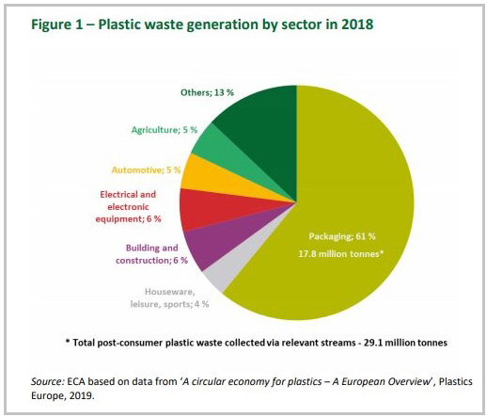
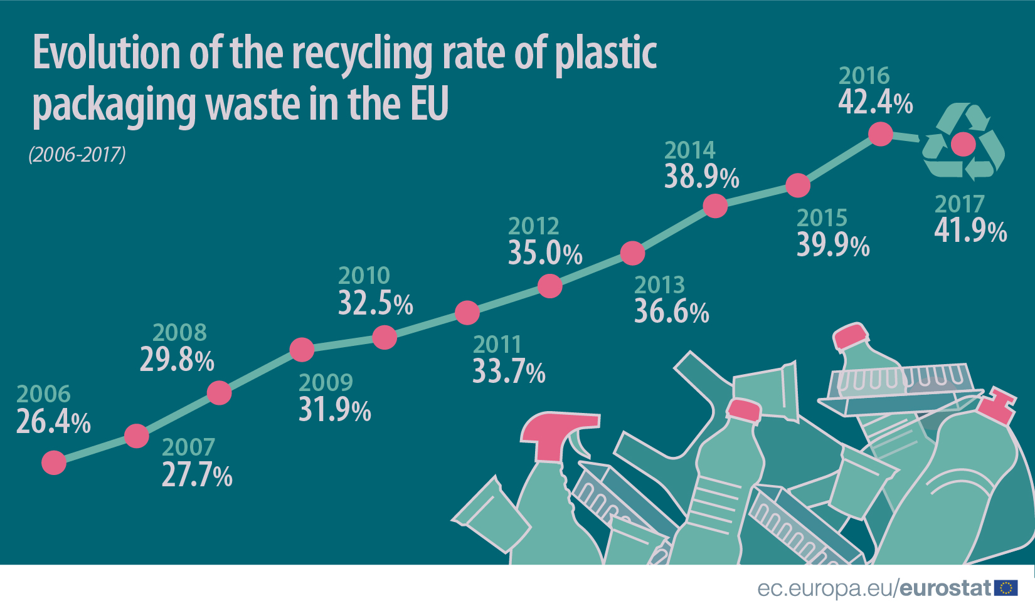
Plastics in Europe:
Not circular enough
high production, low recycling rates
Plastic Packaging: biggest demand, biggest waste stream in the EU-28

Slide 4
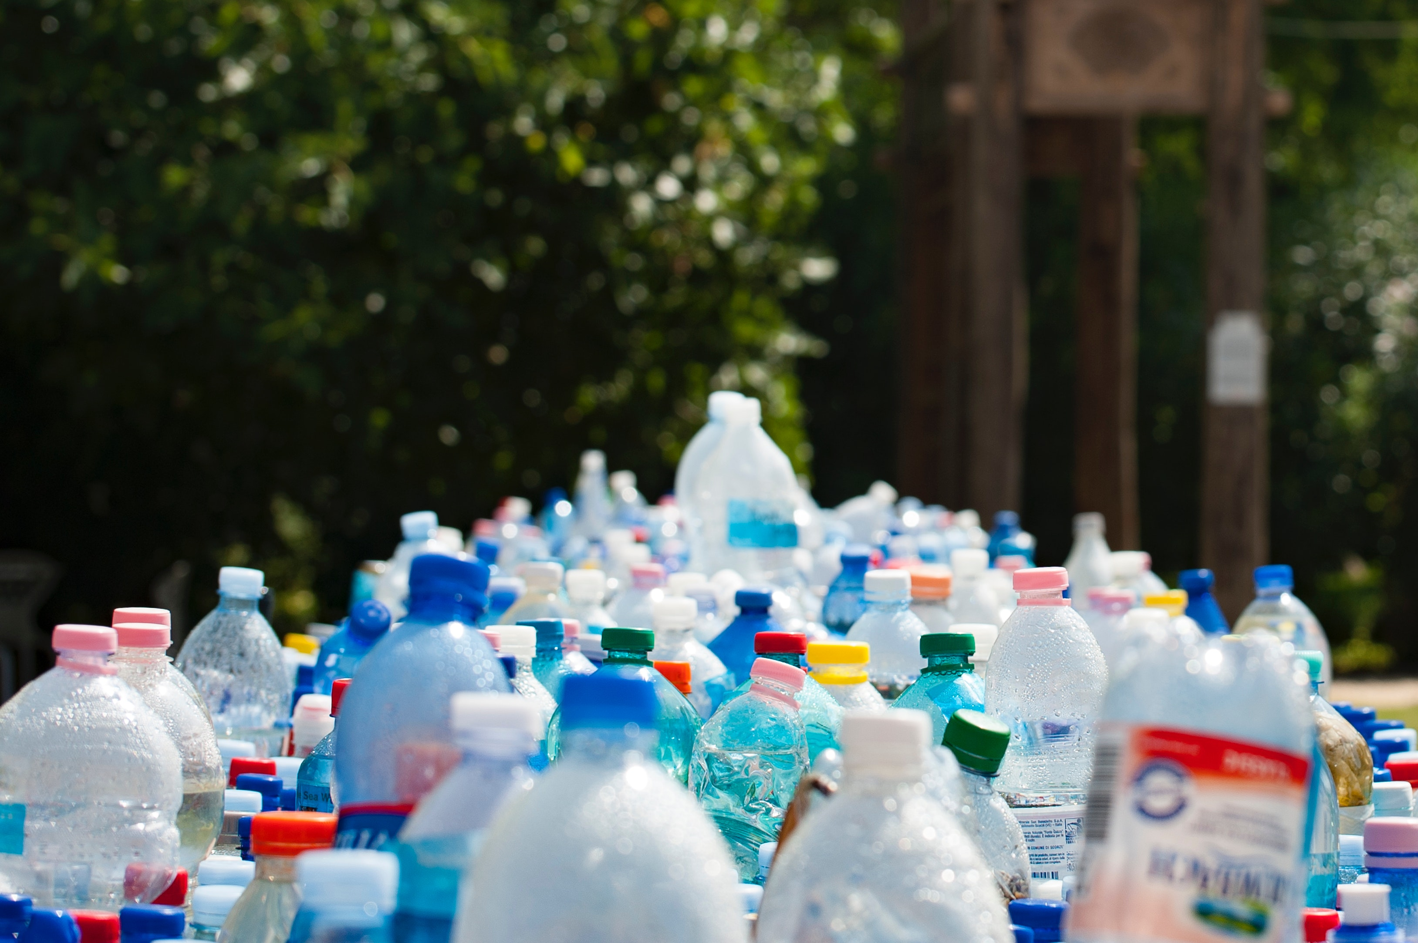
Increasing the demand for plastic recyclates
Binding regulatory tools are needed to boost the demand for recyclates, especially:
Mandatory recycled content rules
The example of the SUP Directive:
Ambitious collection targets (90% by 2027)
25% mandatory recycled content in PET bottles in 2025, 30% in all plastic bottles in 2030
Immediate result after the adoption of the Directive on R- PET prices: no more dependency on volatile primary raw
material prices
Mandatory Green Public Procurement rules
Investments along the plastic waste value chain are needed. With sufficient investment security, private investments of € 10 billion are expected in recycling facilities in the next 10 years.

Slide 5
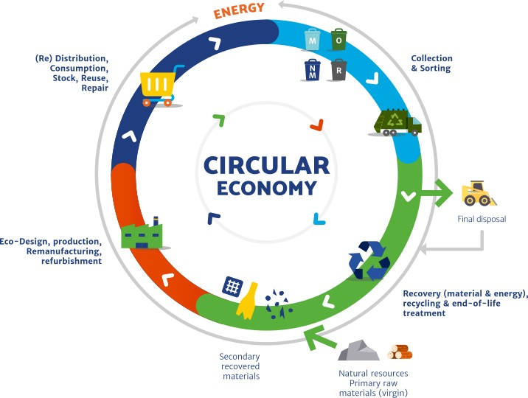
Prerequisites for high quality recyclates: eco-design and selective collection
Quality improvements require an approach that considers all steps in the product life cycle, including its end-of-life:
Eco-design is a driver for quality recyclates, as it:
ensures recyclability
encompasses mandatory recycling content rules
Developing and improving selective collection schemes
Selective collection schemes should be broadly developed and enforced as they lead to quality recyclates. They exist in a few MS, but not in all. However, they should not be harmonized across the EU.
In principle, open markets and B-to-B contracts should be preferred to EPR schemes.

Slide 6
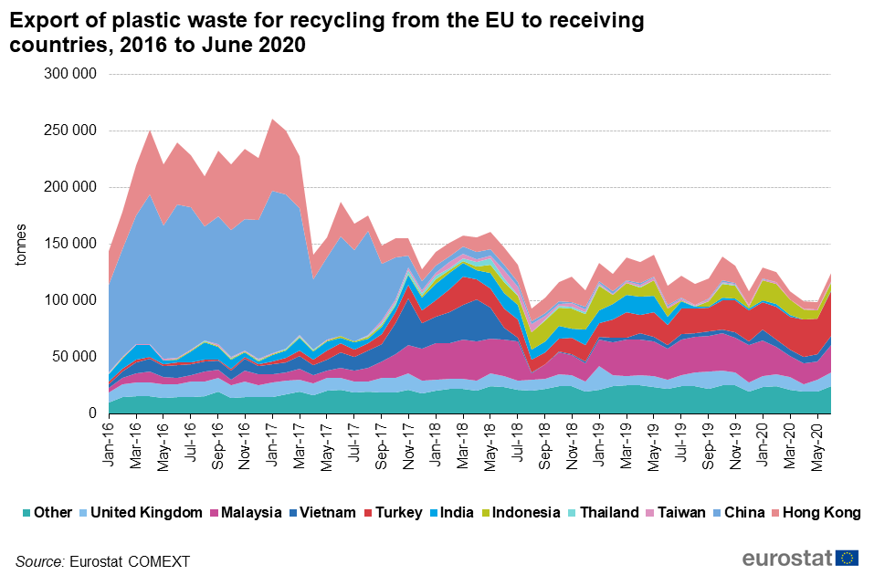
Closing the loop in EU, with safe and efficient intra-EU waste shipment rules
Intra-EU plastic waste shipments are crucial for the circular economy
Import and export of plastic and plastic waste are part of the circular economy.
Due to the variety of polymers, products, packaging, additives, uses, etc., no EU country has the full range of recycling and waste management options in place.
3. Intensified enforcement efforts against illegal exports and waste crime, including illegal waste handling.

Slide 7
Thank you for
your attention
Contact
president@fead.be
Social media
Website
www.fead.be

