Slide 1

COMPLIANCE COUNTDOWN:
YOUR NEW SCIP DATABASE REQUIREMENTS
1st June 2021

Slide 2
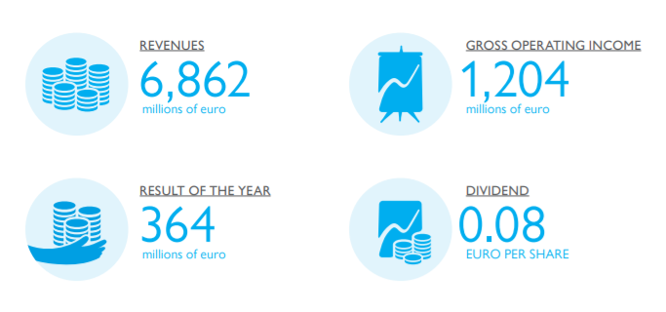




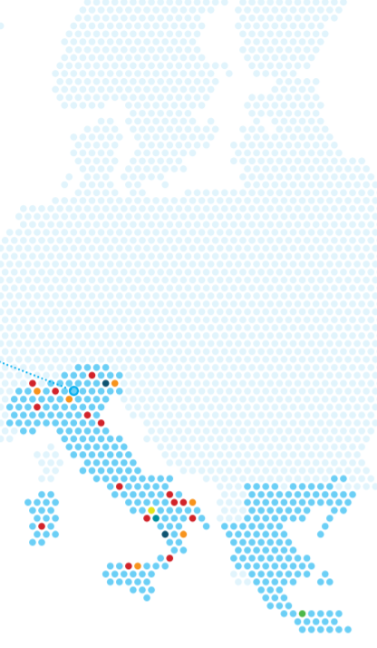
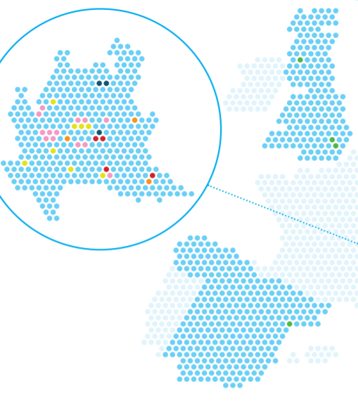
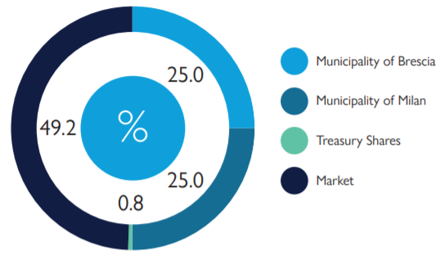
A2A GROUP
^{At December 31, 2020}
INTEGRATED AND BALANCED BUSINESS MIX
6,862 M€ REVENUES
364M€ RESULT OF THE YEAR
WASTE
MARKET
NETWORKS
GENERATION
Value from end to beginning
More solutions to involve customers
Smarter and more reliable
Flexible and greener energy
1,204M€ GROSS OPERATING INCOME
GEOGRAPHICAL AREAS OF ACTIVITY
0,08€ per share DIVIDENDS
A2A SHAREHOLDING STRUCTURE
Municipality of Brescia
Municipality of Milan
Treasury Shares
Market

Slide 3

























WASTE BUSINESS UNIT
Waste treatment and recovery Plants
MSW Collection
Subsidiaries

Slide 4
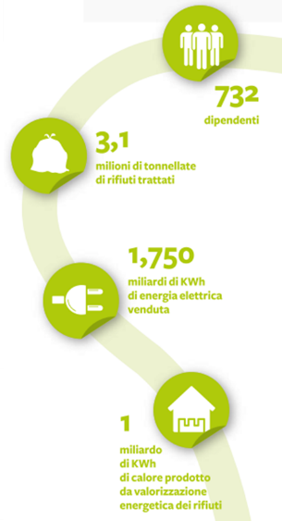


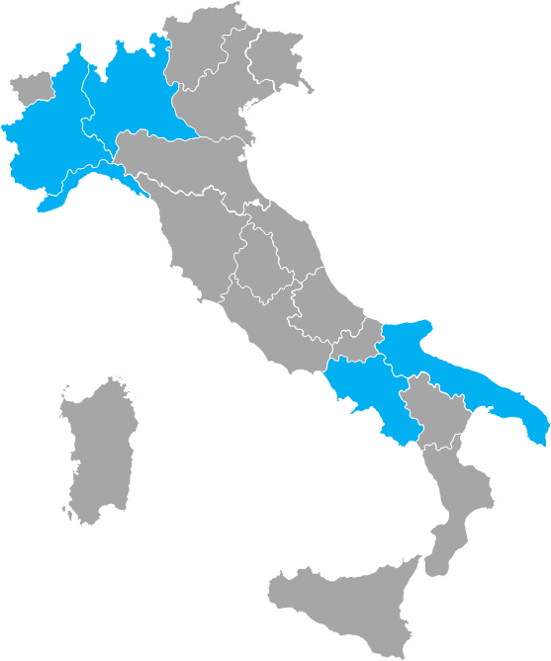



WASTE BUSINESS UNIT: KEY FIGURES
5,900
employees
Italian market Leader in material and energy recovery through waste valorization
14 Material Recovery Plants
~6.6 Mt of waste managed
9 WtE
9 MBT Plants
5 multifunctional platforms
1.8 billion kWh electric energy from waste
1.5 billion kWh thermal energy from waste
3 organic waste treatment plants
3 landfills
3.5 millions people served
Financial Highlights M€
 | 2018 | 2019 | 2020
Revenues | 1,022 | 1,047 | 1,106
EBITDA | 265 | 267 | 282

Slide 5

CRITICAL ISSUES ON RECYCLING
Missing information related to which chemicals are found in the different waste streams, and how these can be treated in a safe and environmentally sound manner
Specific attention should be given to imported goods, especially through online sales, which represent a challenge
Striking a balance between companies’ investments and tackling harmful chemicals in products
Standardised methods to analyse different chemicals are not always available

Slide 6


POSITION ON SCIP DATABASE
There is currently an information deficit
Information is essential for:
SAFETY (workers and environment)
COMPLIANCE with requirements on traceability
PROPER waste treatment
QUALITY of recovered material

Slide 7

PRIVATE WASTE MANAGEMENT’S NEEDS
Reliable information on each waste stream in order to produce risk-free recycled materials
Clear, simple, and usable information regarding the presence or absence of substances of concern (and even more)
Respect of legal thresholds

Slide 8

COMPLETE INFORMATION FLOW
A complete information flow is attainable by:
Improving cooperation between manufacturers and the waste management sector
Supporting the use of digital solutions for improved information flows
Providing a clear and simple methodology to indicate the presence of substances of concern in waste streams

Slide 9
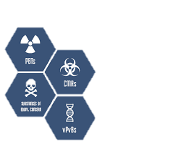
CURRENT PRACTICES TO HANDLE SVHC
Depends on the stream and the type of waste
Normally: collect separately and track hazardous components. Then separate the hazardous component from the article.
Waste origin is important
Waste classification level: need to check presence of specific substances
Without data: time and money to conduct analysis
Important to have a database where waste recyclers can see which substances are contained in a category of products

Slide 10

REMOVAL OF HAZARDOUS SUBSTANCES
Today, waste treatment and recycling operators use both scientific and practical knowledge gained during day-to-day operations to remove waste fractions that contain hazardous or legacy substances. E.g.:
Characterized plastic waste streams with phthalates (based on previous analyses) are separated from recyclable materials
ELV waste management: certain car models are known to contain persistent organic pollutants more likely than others and can be separated before dismantling and shredding

Slide 11

RISK FOR WORKERS
Risk for workers due to the presence of hazardous substances in waste streams coming from articles that are not already managed by existing OHS measures
The database aims at supporting the waste management industry in gathering information on SVHC in recyclable materials, as requested by the revised Waste Framework Directive
There’s a need to protect workers and therefore need for better information (scientific studies and not only database information)

Slide 12

TESTING STANDARDS
Kind of testing standards used and their frequency
At the moment all alternatives are used
Treatment facilities have knowledge on substances based on prior testing, information provided by the industry, case studies, etc.
Testing needs and frequency depend on the waste stream and are targeted at streams to be known to contain or to likely contain SVHCs. It also depends on the intended application and the provisions/requirements from the downstream user (industry that is further processing the recyclates)
With better information from the manufacturers, testing can be targeted more efficiently

Slide 13

INFORMATION TO PROCESS WASTE STREAMS
Information To Process / Recycle Our Waste Streams
At the moment, the waste management industry needs more/better information in a usable form. Now, the information we have is limited and it costs a lot of time/money to get it. So, it is worth to improve the system
The usability of information is a key issue to be addressed:
Article-based information vs. product category/waste stream-based information
The waste management industry mainly manages streams, not single articles (information on single articles would be too time and money consuming), but it’s not easy to define a waste stream
Data should be per article, but then aggregation is needed to be usable

Slide 14

ADDITIONAL INFORMATION NEEDED - 1
Information on waste that can be utilised to decide if recycling is possible either directly or after decontamination
Also hazardous substances can be recycled, not every recycling needs a complete decontamination (e.g., batteries or waste oil) - there will always be substances requiring care in the further handling
Waste recycling industries need to know what to search/look for
Ensure that recyclates contain no SVHCs submitted to restriction or authorisation

Slide 15

ADDITIONAL INFORMATION NEEDED - 2
Knowing the content, recyclers can collect separately specific waste streams or try to sort out elements that contain SVHCs before any further process, specifically mechanical recycling
It's important to have more information about the concentration, especially regarding SVHCs
We do not know which substances will be considered of high concern in 5-10 years when those products become waste

Slide 16

QUESTIONS FROM WASTE MANAGEMENT SECTOR
How to use information provided by the SCIP database if we receive waste in bulks?
Ask for a guidance/methodology on how to deal with specific waste streams containing legacy substances at the treatment phase (after the considered waste stream has been classified according to the current hazard-based approach, see remark below) . This could be based on a risk assessment and applied on a case-by-case basis
NO question of the existing methodology for classifying HW based on hazardousness criteria
Waste management rules to be risk-based, HW classification to remain hazard-based

Slide 17

OUR SUGGESTIONS
If other tools exist that cover at least the same list of substances (e.g., IMDS for automotive industry), information should be grouped in one place only.
Will not be efficient to have multiple and possibly overlapping databases
We need concrete and simple information that can be easily aggregated, in order to be usable for waste managers, from the producers in order to know what to search/look for.

Slide 18

CONCLUSIONS
Ask for a decision tree/methodology for the treatment phase (after classification), for a risk-based guidance on waste management
For specific waste streams and closed loops, asking for a derogation allowing to further recycle these Secondary Raw Materials (in closed loops), provided it entails a suitable degree of traceability
Broaden the scope of SCIP database in the future by adding other substances of concern

Slide 19
Thank you for
your attention
claudia.mensi@a2a.eu

